Slide 1

RNNs in TensorFlow
CS 20: TensorFlow for Deep Learning Research
Lecture 11
2/21/2017

Slide 3
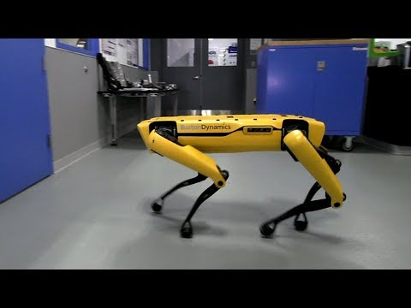
Boston Dynamics

Slide 4
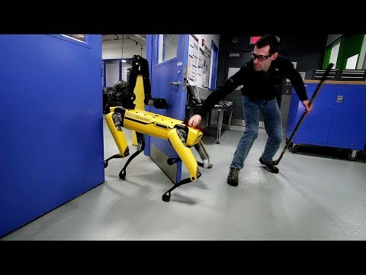
Human vs SpotMini

Slide 5
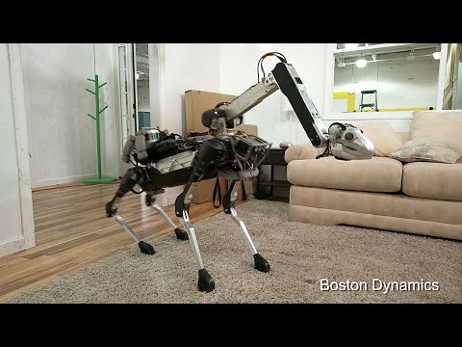
The original SpotMini

Slide 6
Agenda
From feed-forward to recurrent
Tricks & treats
Presidential tweets

Slide 7
Introduction to RNNs

Slide 8
Humans aren’t built to just do linear or logistic regression, or recognize individual objects

Slide 9
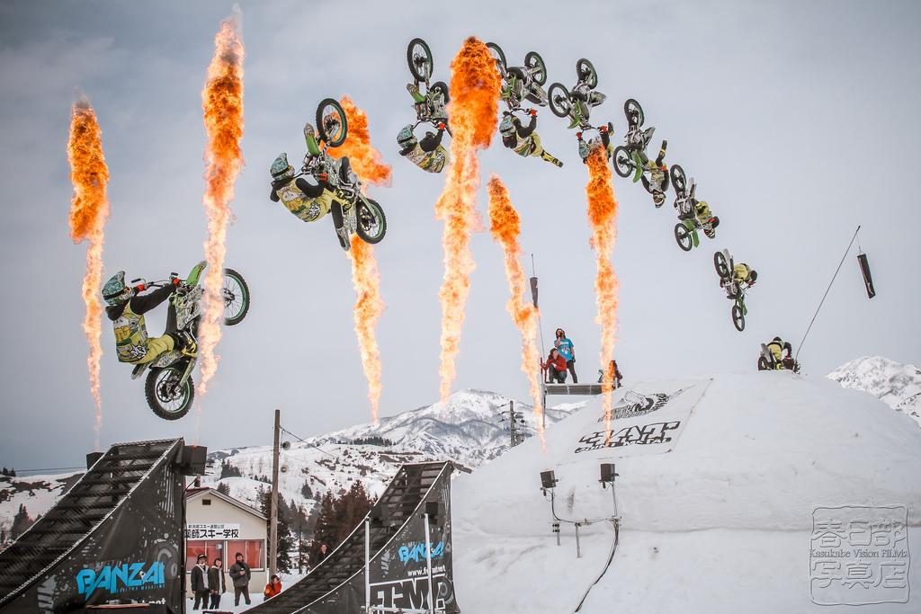
Super Indy Flip by Kasukabe Vision FILMz✔ (flickr)

Slide 10
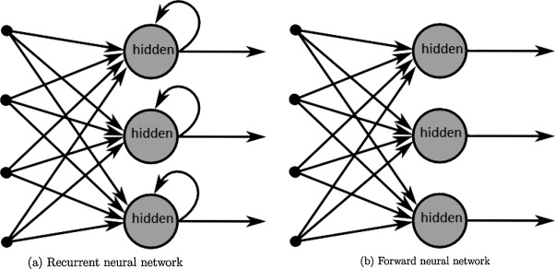
From feed-forward to RNNs
"A survey on the application of recurrent neural networks to statistical language modeling." by De Mulder et al. Computer Speech & Language 30.1 (2015): 61-98.

Slide 11
From feed-forward to RNNs
Feed-forward | RNNs
computational unit (neuron) | computational unit (neuron)
DAG | Loops
Signals are passed in one direction (input to output) | Signals are sent back to the same neuron
Each layer has their own variables | All steps share the same variables

Slide 12
Why RNNs
Take advantage of sequential information of data (texts, genomes, videos, etc.)
Generally reduce the total number of parameters
Form the backbone of NLP

Slide 13
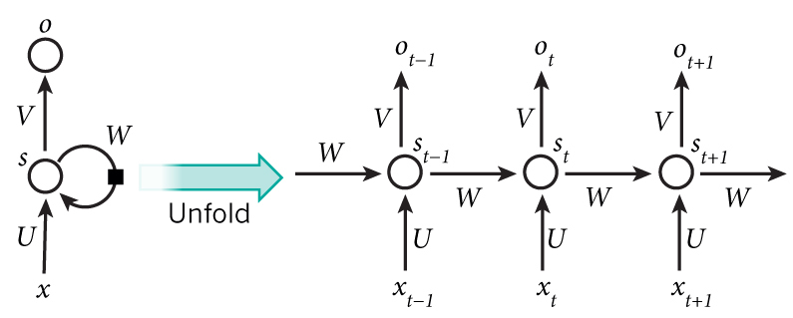
RNNs unfolded
Graph by Nature
Notes:
You might find it easier to think of those neurons as they are unfolded: each neuron corresponds to one time step.

Slide 14
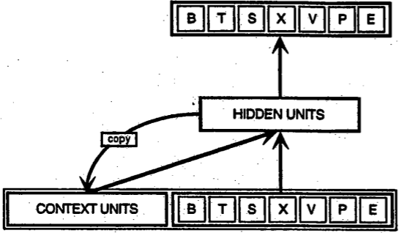
Simple Recurrent Neural Network (SRN)
Introduced by Jeffrey Elman in 1990. Also known as Elman Network
Elman, Jeffrey L. "Finding structure in time." Cognitive science 14.2 (1990): 179-211.

Slide 15
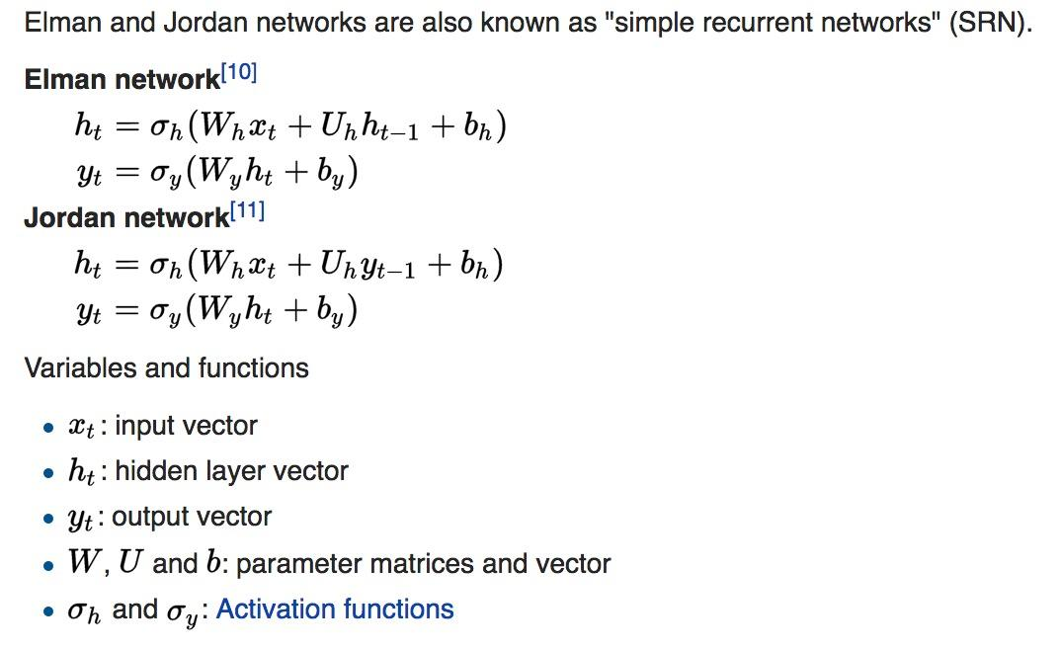
Simple RNNs are Simple
Source: Wikipedia

Slide 16
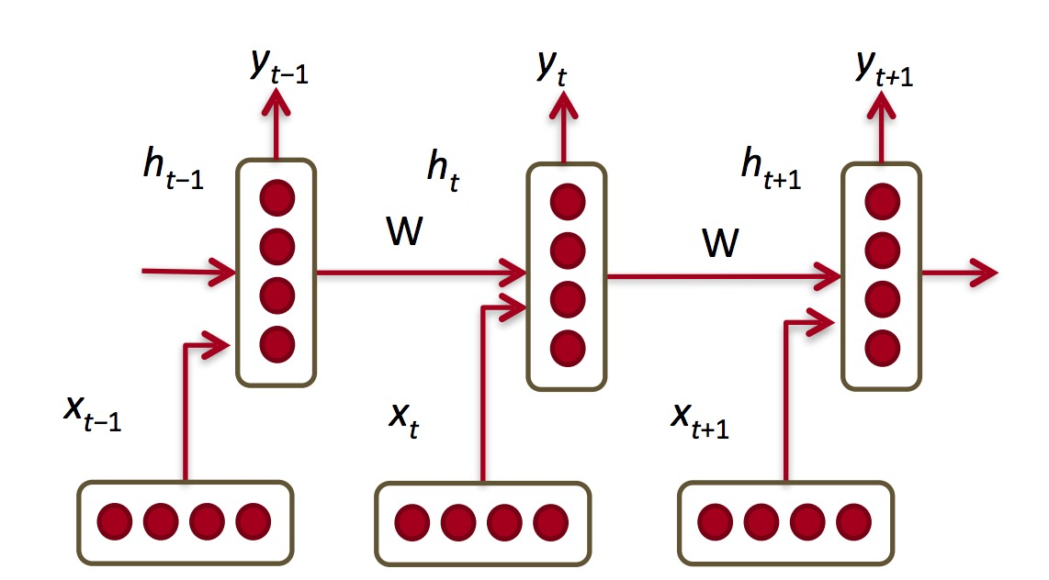
RNNs in the context of NLP
Diagram from CS 224D’s slides

Slide 17
RNNs in the context of NLP
Two inputs each step:
current input
prev step’s state
Diagram from CS 224D’s slides

Slide 18
Back-propagation
through time

Slide 19
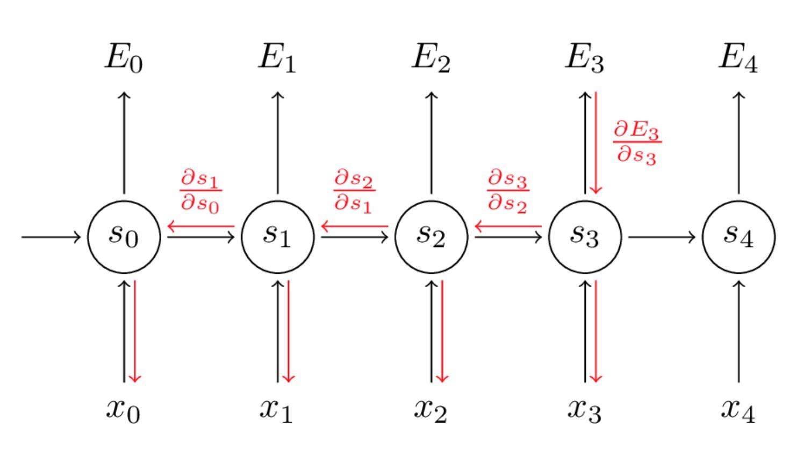
Back-propagation Through Time (BPTT)
Graph by Denny Britz (blog)

Slide 20
BPTT
Use sum of gradients each all timesteps to update parameters
Computationally expensive for a lot of timesteps

Slide 21
Truncated BPTT
A fixed number of timesteps

Slide 22
Truncated BPTT
A fixed number of timesteps
Won’t be able to capture the full sequential dependencies
In non-eager TensorFlow, have to make sure all inputs are of the same length

Slide 23
Exploding/vanishing Gradients
Graph by Denny Britz (blog)

Slide 24
The problem with RNNs
In practice, RNNs aren’t very good at capturing long-term dependencies
“I grew up in France… I speak fluent ???”
-> Needs information from way back

Slide 25
Gated Recurrent Units

Slide 26
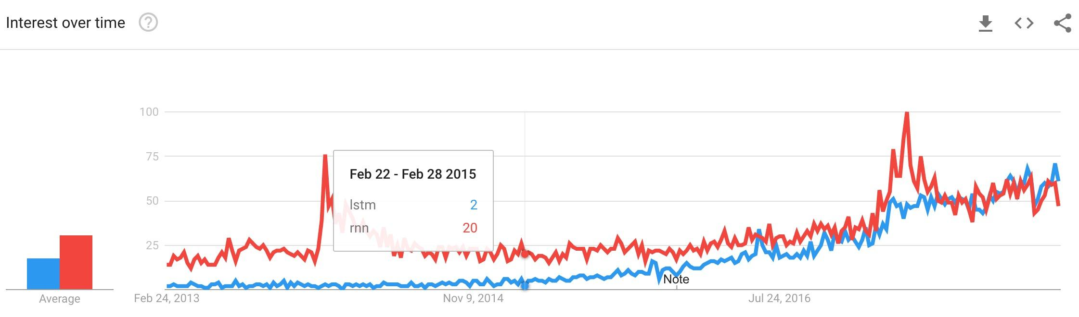
The rise of LSTMs

Slide 27
The rise of LSTMs
Using a gating mechanism to control what information to enter and emit from the cell at each timestep

Slide 28
The rise of LSTMs
input gate: how much of the current input to let through.
forget gate: how much of the previous state to take into account.
output gate: how much of the hidden state to expose to the next step.
candidate gate
final memory cell
Notes:
candidate gate: similar to the original RNN, this gate computes the candidate hidden state based on the previous hidden state and the current input.
final memory cell: the internal memory of the unit combines the candidate hidden state with the input/forget gate information. Final memory cell is then computed with the output gate to decide how much of the final memory cell is to be output as the hidden state for this current step.

Slide 29
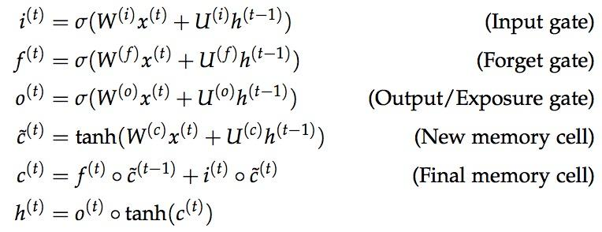
The rise of LSTMs
From CS 224D Lecture Note

Slide 30
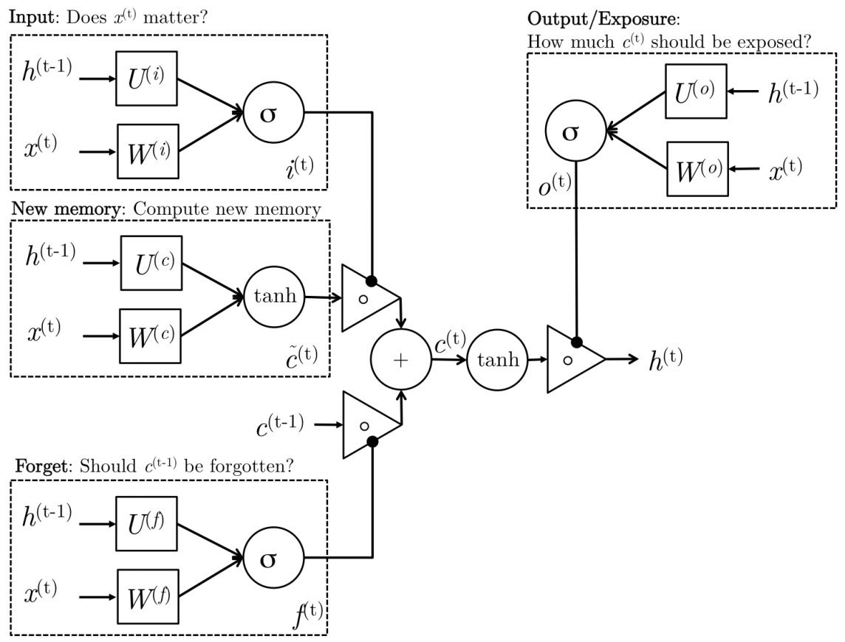
The rise of LSTMs
From CS 224D Lecture Note

Slide 31
The rise of LSTMs
Closer to how humans process information
The idea is not new. Hochreiter and Schmidhuber published the paper in 1997*
*Hochreiter, Sepp, and Jürgen Schmidhuber. "Long short-term memory." Neural computation 9.8 (1997): 1735-1780.

Slide 32
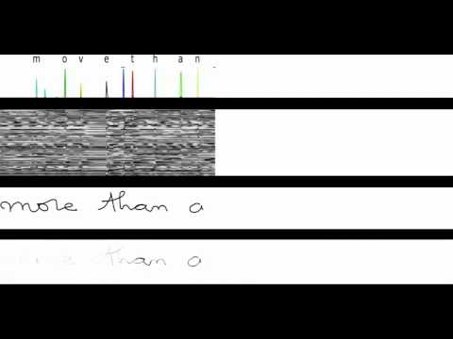
The rise of LSTMs
Visualization of LSTM in action by Alex Graves (DeepMind)
Notes:
1) Row 1: Shows when the letters are recognized
2) Row 2: Shows the states of some of the memory cells (Notice how they get reset when a character is recognized!)
3) Row 3: Shows the writing as it's being analyzed by the LSTM RNN 4)
4) Row 4: This shows the gradient backpropagated to the inputs from the most active character of the upper soft-max layer (This tells you which data points are providing the most influence on your current decision for the character)

Slide 33
LSTMs vs GRUs
People find LSTMs work well, but unnecessarily complicated, so they introduced GRUs

Slide 34
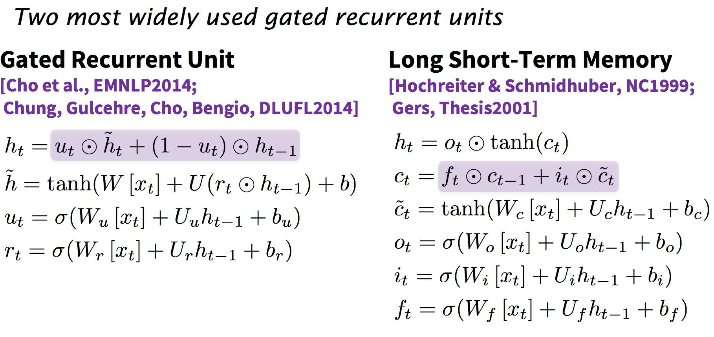
GRUs (Gated Recurrent Units)
From CS 224D Lecture Note

Slide 35
GRUs (Gated Recurrent Units)
Computationally less expensive
Performance on par with LSTMs*
*Chung, Junyoung, et al. "Empirical evaluation of gated recurrent neural networks on sequence modeling." arXiv preprint arXiv:1412.3555 (2014).

Slide 36
What can RNNs do?

Slide 37
Language Modeling
Allows us to measure how likely a sentence is
Important input for Machine Translation (since high-probability sentences are typically correct)
Can generate new text

Slide 38
Character-level Language Modeling
PANDARUS:
Alas, I think he shall be come approached and the day
When little srain would be attain'd into being never fed,
And who is but a chain and subjects of his death,
I should not sleep.
Second Senator:
They are away this miseries, produced upon my soul,
Breaking and strongly should be buried, when I perish
The earth and thoughts of many states.
DUKE VINCENTIO:
Well, your wit is in the care of side and that.
Second Lord:
They would be ruled after this chamber, and
my fair nues begun out of the fact, to be conveyed,
Whose noble souls I'll have the heart of the wars.
Clown:
Come, sir, I will make did behold your worship.
Shakespeare Generator
Andrej Karpathy’s blog

Slide 39
Character-level Language Modeling
/*
* Increment the size file of the new incorrect UI_FILTER group information
* of the size generatively.
*/
static int indicate_policy(void)
{
int error;
if (fd == MARN_EPT) {
/*
* The kernel blank will coeld it to userspace.
*/
if (ss->segment < mem_total)
unblock_graph_and_set_blocked();
else
ret = 1;
goto bail;
}
segaddr = in_SB(in.addr);
selector = seg / 16;
setup_works = true;
for (i = 0; i < blocks; i++) {
seq = buf[i++];
bpf = bd->bd.next + i * search;
if (fd) {
current = blocked;
}
}
rw->name = "Getjbbregs";
bprm_self_clearl(&iv->version);
regs->new = blocks[(BPF_STATS << info->historidac)] | PFMR_CLOBATHINC_SECONDS << 12;
return segtable;
}
Linux Source Code Generator
Andrej Karpathy’s blog

Slide 40
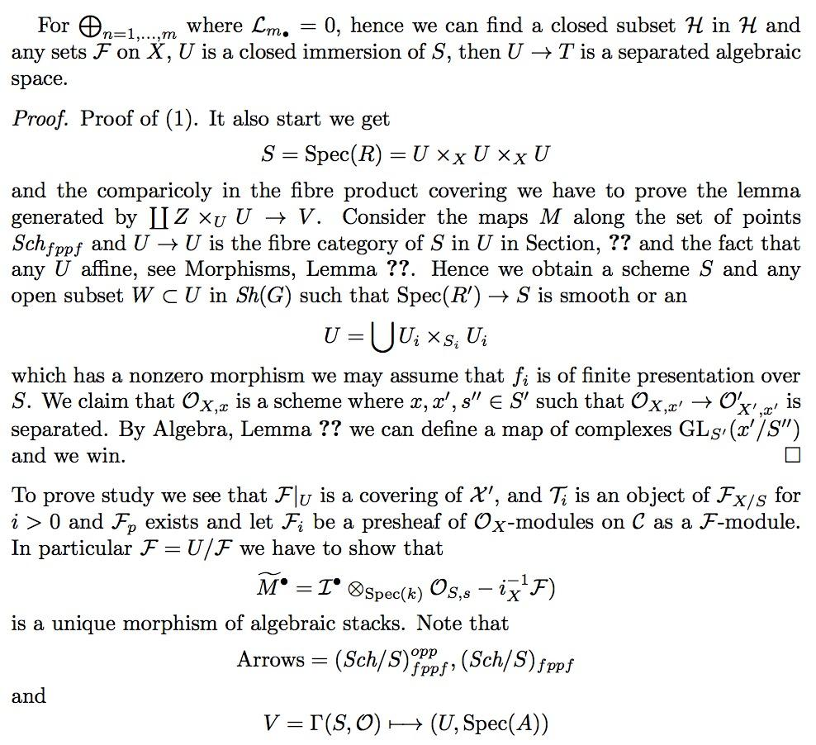
Character-level Language Modeling
Fake Math Doc Generator
Andrej Karpathy’s blog

Slide 41
Character-level Language Modeling
Deep learning neural network architectures can be used to best developing a new architectures contros of the training and max model parametrinal Networks (RNNs) outperform deep learning algorithm is easy to out unclears and can be used to train samples on the state-of-the-art RNN more effective Lorred can be used to best developing a new architectures contros of the training and max model and state-of-the-art deep learning algorithms to a similar pooling relevants. The space of a parameter to optimized hierarchy the state-of-the-art deep learning algorithms to a simple analytical pooling relevants. The space of algorithm is easy to outions of the network are allowed at training and many dectional representations are allow develop a groppose a network by a simple model interact that training algorithms to be the activities to maximul setting, ...
Fake Arvix Abstracts Generator
We’ll build this!!!!

Slide 42
Character-level Language Modeling
I will be interviewed on @foxandfriends tonight at 10:00 P.M. and the #1 to construct the @WhiteHouse tonight at 10:00 P.M. Enjoy __HTTP__
No matter the truth and the world that the Fake News Media will be a great new book #Trump2016 __HTTP__ __HTTP__
Great poll thank you for your support of Monday at 7:30 A.M. on NBC at 7pm #Trump2016 #MakeAmericaGreatAgain #Trump2016 __HTTP__ __HTTP__
The Senate report to our country is a total disaster. The American people who want to start like a total disaster. The American should be the security 5 star with a record contract to the American peop
.@BarackObama is a great president of the @ApprenticeNBC
No matter how the U.S. is a complete the ObamaCare website is a disaster.
Presidential tweets
We’ll build this!!!!

Slide 43
Machine Translation
Google Neural Machine Translation (Google Research’s blog)

Slide 44
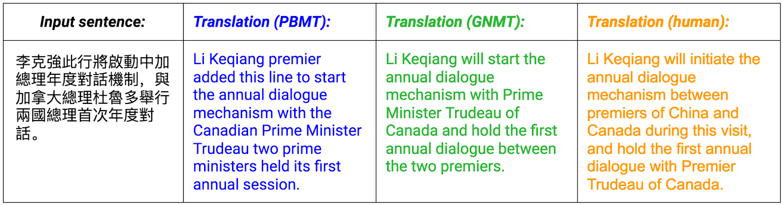
Machine Translation
Google Neural Machine Translation (Google Research’s blog)
Notes:
Whereas Phrase-Based Machine Translation (PBMT) breaks an input sentence into words and phrases to be translated largely independently, Neural Machine Translation (NMT) considers the entire input sentence as a unit for translation.

Slide 45
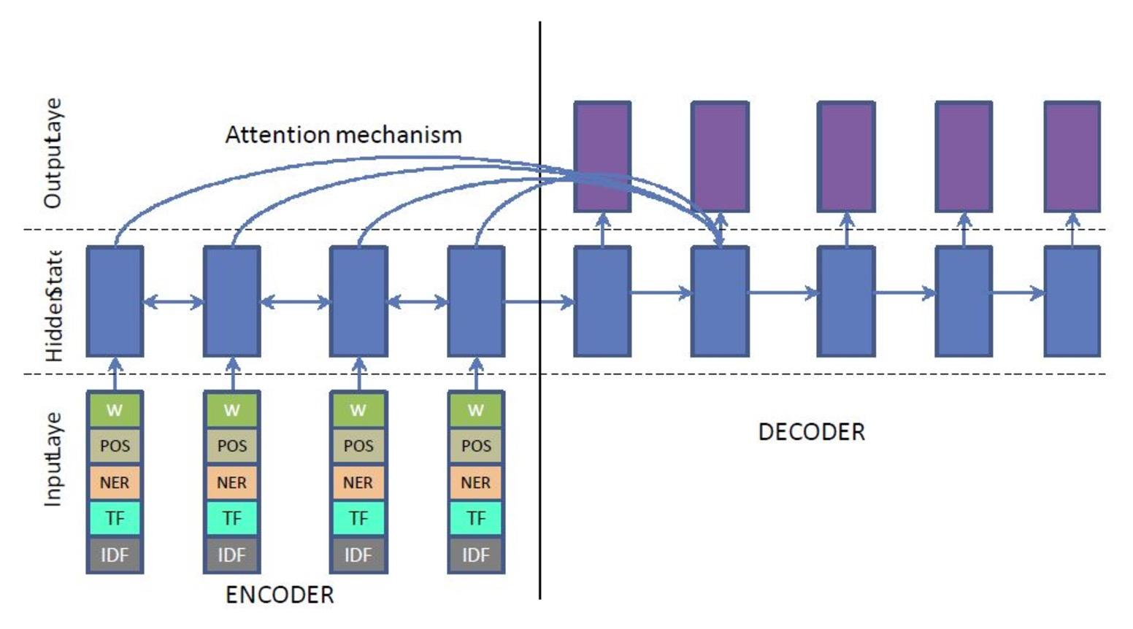
Text Summarization
Nallapati, Ramesh, et al. "Abstractive text summarization using sequence-to-sequence rnns and beyond." arXiv preprint arXiv:1602.06023 (2016).

Slide 46
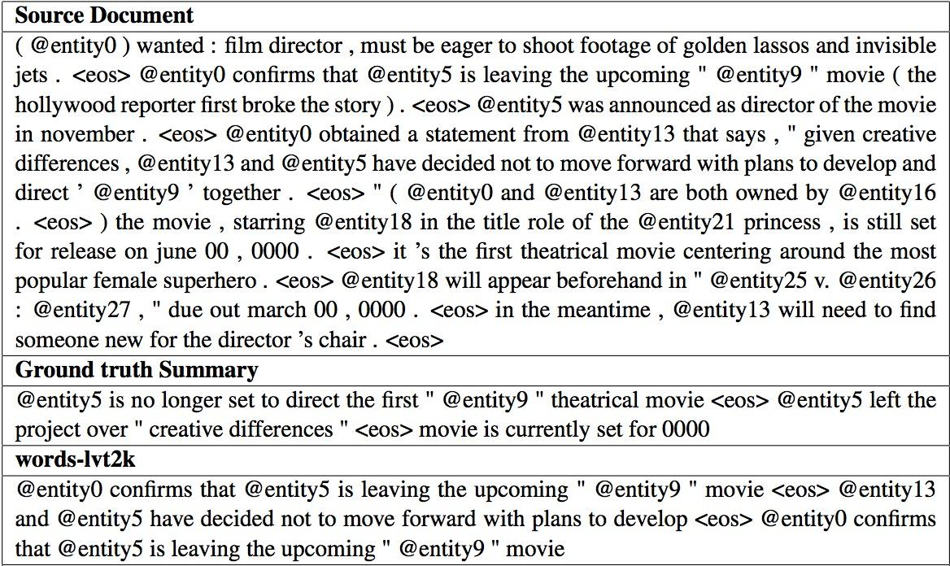
Text Summarization
Nallapati, Ramesh, et al. "Abstractive text summarization using sequence-to-sequence rnns and beyond." arXiv preprint arXiv:1602.06023 (2016).

Slide 47
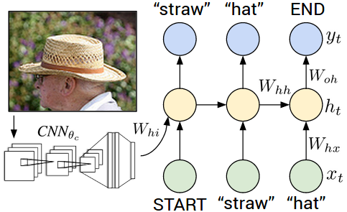
Image Captioning
Karpathy, Andrej, and Li Fei-Fei. "Deep visual-semantic alignments for generating image descriptions." Proceedings of the IEEE Conference on Computer Vision and Pattern Recognition. 2015.

Slide 48
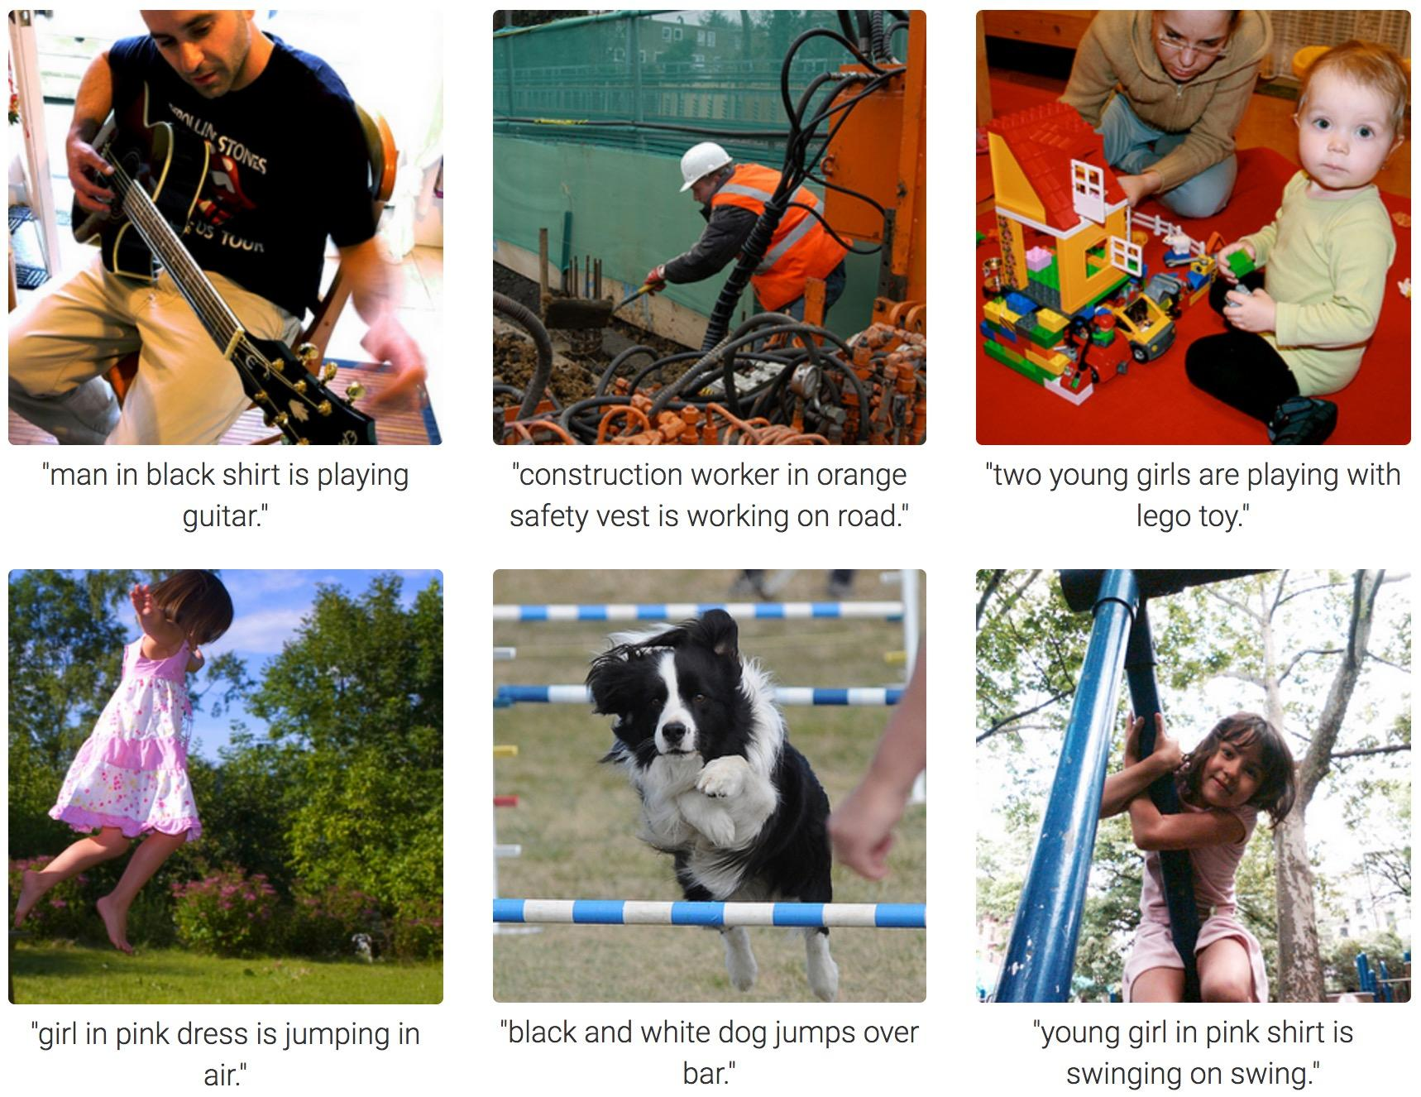
Image Captioning
Karpathy, Andrej, and Li Fei-Fei. "Deep visual-semantic alignments for generating image descriptions." Proceedings of the IEEE Conference on Computer Vision and Pattern Recognition. 2015.

Slide 49
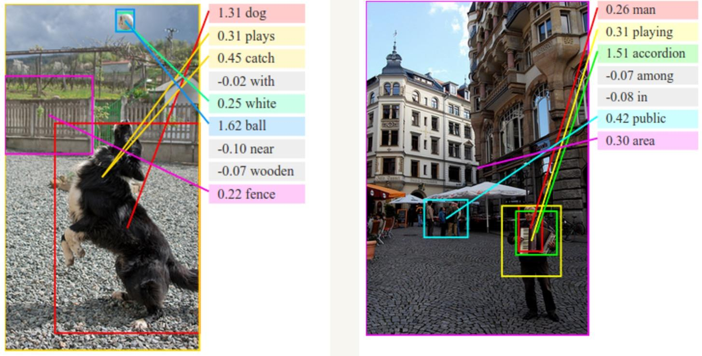
Image Captioning
Karpathy, Andrej, and Li Fei-Fei. "Deep visual-semantic alignments for generating image descriptions." Proceedings of the IEEE Conference on Computer Vision and Pattern Recognition. 2015.

Slide 50
RNNs in TensorFlow

Slide 51
Cell Support (tf.nn.rnn_cell)
BasicRNNCell: The most basic RNN cell.
RNNCell: Abstract object representing an RNN cell.
BasicLSTMCell: Basic LSTM recurrent network cell.
LSTMCell: LSTM recurrent network cell.
GRUCell: Gated Recurrent Unit cell

Slide 52
Construct Cells (tf.nn.rnn_cell)
cell = tf.nn.rnn_cell.GRUCell(hidden_size)

Slide 53
Stack multiple cells
layers = [tf.nn.rnn_cell.GRUCell(size) for size in hidden_sizes]
cells = tf.nn.rnn_cell.MultiRNNCell(layers)

Slide 54
Construct Recurrent Neural Network
tf.nn.dynamic_rnn: uses a tf.While loop to dynamically construct the graph when it is executed. Graph creation is faster and you can feed batches of variable size.
tf.nn.bidirectional_dynamic_rnn: dynamic_rnn with bidirectional

Slide 55
Stack multiple cells
layers = [tf.nn.rnn_cell.GRUCell(size) for size in hidden_sizes]
cells = tf.nn.rnn_cell.MultiRNNCell(layers)
output, out_state = tf.nn.dynamic_rnn(cell, seq, length, initial_state)
Any problem with this?

Slide 56
Stack multiple cells
layers = [tf.nn.rnn_cell.GRUCell(size) for size in hidden_sizes]
cells = tf.nn.rnn_cell.MultiRNNCell(layers)
output, out_state = tf.nn.dynamic_rnn(cell, seq, length, initial_state)
Most sequences are not of the same length

Slide 57
Dealing with variable sequence length
Pad all sequences with zero vectors and all labels with zero label (to make them of the same length)
Most current models can’t deal with sequences of length larger than 120 tokens, so there is usually a fixed max_length and we truncate the sequences to that max_length

Slide 58
Dealing with variable sequence length
Pad all sequences with zero vectors and all labels with zero label (to make them of the same length)
Most current models can’t deal with sequences of length larger than 120 tokens, so there is usually a fixed max_length and we truncate the sequences to that max_length
Problem?

Slide 59
Padded/truncated sequence length
The padded labels change the total loss, which affects the gradients

Slide 60
Padded/truncated sequence length
Approach 1:
Maintain a mask (True for real, False for padded tokens)
Run your model on both the real/padded tokens (model will predict labels for the padded tokens as well)
Only take into account the loss caused by the real elements
full_loss = tf.nn.softmax_cross_entropy_with_logits(preds, labels)
loss = tf.reduce_mean(tf.boolean_mask(full_loss, mask))
Notes:
It does not allow cell clipping, a projection layer, and does not use peep-hole connections: it is the basic baseline.

Slide 61
Padded/truncated sequence length
Approach 2:
Let your model know the real sequence length so it only predict the labels for the real tokens
cell = tf.nn.rnn_cell.GRUCell(hidden_size)
rnn_cells = tf.nn.rnn_cell.MultiRNNCell([cell] * num_layers)
tf.reduce_sum(tf.reduce_max(tf.sign(seq), 2), 1)
output, out_state = tf.nn.dynamic_rnn(cell, seq, length, initial_state)
Notes:
It does not allow cell clipping, a projection layer, and does not use peep-hole connections: it is the basic baseline.

Slide 62
Tips and Tricks

Slide 63
Vanishing Gradients
Use different activation units:
tf.nn.relu
tf.nn.relu6
tf.nn.crelu
tf.nn.elu
In addition to:
tf.nn.softplus
tf.nn.softsign
tf.nn.bias_add
tf.sigmoid
tf.tanh

Slide 64
Exploding Gradients
Clip gradients with tf.clip_by_global_norm
gradients = tf.gradients(cost, tf.trainable_variables())
clipped_gradients, _ = tf.clip_by_global_norm(gradients, max_grad_norm)
optimizer = tf.train.AdamOptimizer(learning_rate)
train_op = optimizer.apply_gradients(zip(gradients, trainables))

Slide 65
Exploding Gradients
Clip gradients with tf.clip_by_global_norm
gradients = tf.gradients(cost, tf.trainable_variables())
# take gradients of cosst w.r.t. all trainable variables
clipped_gradients, _ = tf.clip_by_global_norm(gradients, max_grad_norm)
optimizer = tf.train.AdamOptimizer(learning_rate)
train_op = optimizer.apply_gradients(zip(gradients, trainables))

Slide 66
Exploding Gradients
Clip gradients with tf.clip_by_global_norm
gradients = tf.gradients(cost, tf.trainable_variables())
# take gradients of cosst w.r.t. all trainable variables
clipped_gradients, _ = tf.clip_by_global_norm(gradients, max_grad_norm)
# clip the gradients by a pre-defined max norm
optimizer = tf.train.AdamOptimizer(learning_rate)
train_op = optimizer.apply_gradients(zip(gradients, trainables))

Slide 67
Exploding Gradients
Clip gradients with tf.clip_by_global_norm
gradients = tf.gradients(cost, tf.trainable_variables())
# take gradients of cosst w.r.t. all trainable variables
clipped_gradients, _ = tf.clip_by_global_norm(gradients, max_grad_norm)
# clip the gradients by a pre-defined max norm
optimizer = tf.train.AdamOptimizer(learning_rate)
train_op = optimizer.apply_gradients(zip(gradients, trainables))
# add the clipped gradients to the optimizer

Slide 68
Anneal the learning rate
Optimizers accept both scalars and tensors as learning rate
learning_rate = tf.train.exponential_decay(init_lr,
global_step,
decay_steps,
decay_rate,
staircase=True)
optimizer = tf.train.AdamOptimizer(learning_rate)

Slide 69
Overfitting
Use dropout through tf.nn.dropout or DropoutWrapper for cells
tf.nn.dropout
hidden_layer = tf.nn.dropout(hidden_layer, keep_prob)
DropoutWrapper
cell = tf.nn.rnn_cell.GRUCell(hidden_size)
cell = tf.nn.rnn_cell.DropoutWrapper(cell,
output_keep_prob=keep_prob)

Slide 70
Language Modeling

Slide 71
Neural Language Modeling
Allows us to measure how likely a sentence is
Important input for Machine Translation (since high-probability sentences are typically correct)
Can generate new text

Slide 72
Language Modeling: Main approaches
Word-level: n-grams
Character-level
Subword-level: somewhere in between the two above

Slide 73
Language Modeling: N-grams
The traditional approach up until very recently
Train a model to predict the next word based on previous n-grams
What can be the problems?

Slide 74
Language Modeling: N-grams
The traditional approach up until very recently
Train a model to predict the next word based on previous n-grams
Huge vocabulary
Can’t generalize to OOV (out of vocabulary)
Requires a lot of memory

Slide 75
Language Modeling: Character-level
Introduced in the early 2010s
Both input and output are characters
Pros and cons?

Slide 76
Language Modeling: Character-level
Introduced in the early 2010s
Both input and output are characters
Pros:
Very small vocabulary
Doesn’t require word embeddings
Faster to train
Cons:
Low fluency (many words can be gibberish)

Slide 77
Language Modeling: Hybrid
Word-level by default, switching to character-level for unknown tokens

Slide 78
Language Modeling: Subword-Level
Input and output are subwords
Keep W most frequent words
Keep S most frequent syllables
Split the rest into characters
Seem to perform better than both word-level and character-level models*
new company dreamworks interactive
new company dre+ am+ wo+ rks: in+ te+ ra+ cti+ ve:
Mikolov, Tomáš, et al. "Subword language modeling with neural networks." preprint (http://www. fit. vutbr. cz/imikolov/rnnlm/char. pdf) (2012).

Slide 79
Demo:
Char-RNN Language Modeling
Notes:
Let’s be honest, convolutions are weird af

Slide 80
Presidential Tweet Bot
Dataset: 19,469 Donald Trump’s tweets
I guess @edshow is a lot smarter than dopes like @JonahNRO & @stephenfhayes. Oh well both mags are dying anyway. __HTTP__ _E_
Received a standing applause at #NCGOPcon when I said to have free trade be fair for the US we need really intelligent negotiators. _E_
Roger Ailes just called. He is a great guy & assures me that "Trump" will be treated fairly on @FoxNews. His word is always good! _E_
The police in London say I'm right. Major article in Daily Mail. "We can't wear uniform in our own cars." __HTTP__ _E_
#MakeAmericaGreatAgain #Trump2016 __HTTP__ __HTTP__ _E_
When will @BarackObama release his transcripts? What is he hiding? _E_

Slide 81
Presidential Tweet Bot
Evaluation: no foolproof method
I guess @edshow is a lot smarter than dopes like @JonahNRO & @stephenfhayes. Oh well both mags are dying anyway. __HTTP__ _E_
Received a standing applause at #NCGOPcon when I said to have free trade be fair for the US we need really intelligent negotiators. _E_
Roger Ailes just called. He is a great guy & assures me that "Trump" will be treated fairly on @FoxNews. His word is always good! _E_
The police in London say I'm right. Major article in Daily Mail. "We can't wear uniform in our own cars." __HTTP__ _E_
#MakeAmericaGreatAgain #Trump2016 __HTTP__ __HTTP__ _E_
When will @BarackObama release his transcripts? What is he hiding? _E_

Slide 82
GitHub
data/trump_tweets.txt
examples/11_char_nn.py

Slide 83
Next class
Machine Translation
Feedback: huyenn@stanford.edu
Thanks!

